Slide 1

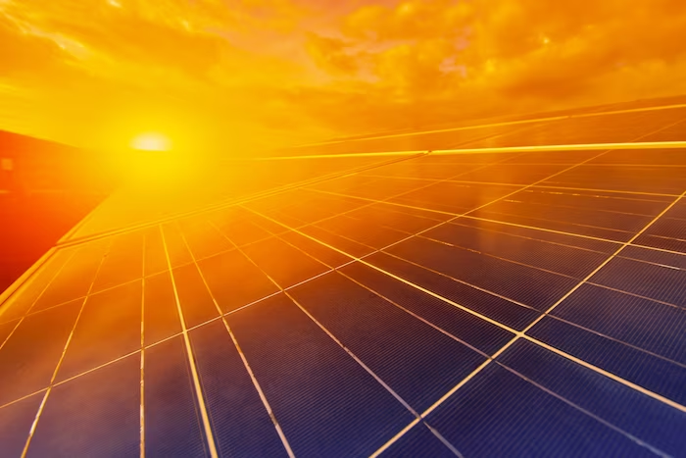
Automatic
Sun Tracking System
CSE251 Lab Project
Summer 2023

Slide 2
Introduction
In this project, we will delve into the fascinating realm
of electronics through a real-world application.
Using the electronic devices we learned in CSE251,
we will build an Automatic Sun Tracking System.

Slide 3
Project Goal
The goal of this project is to design and implement an automatic sun tracking system for a solar panel.
The system will use electronic components such as diodes, Op-Amps, LDRs etc. to determine the relative position of a light source. This info can be used to control the orientation of a solar panel.
This project will provide an opportunity to apply the principles of electronics and circuit design to solve a real world problem.

Slide 4
Learning Outcome
After the project, students should be able to —
Understand the principles of basic electronic components
Learn how to design and implement electronic circuits
Gain experience in using electronic equipment
Practice problem-solving skills and applying theoretical concepts to a real-world problem
Understand the importance of breaking down a problem and testing & debugging the components.
Learn to work in a team on a project with a defined goal and timeline

Slide 5

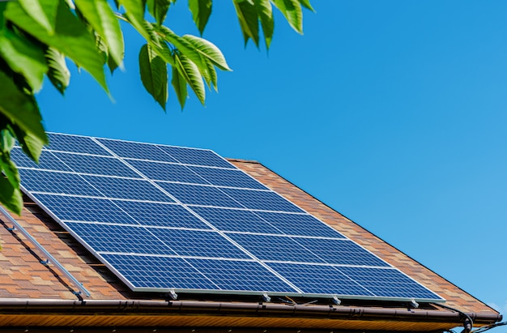
Solar Energy
Solar energy is one of the most well-known kinds of
renewable energy that is
available for consumer-level use.
Solar panels converts
the solar radiation to
electrical energy. The energy is
then stored in a battery
for later use.

Slide 6

The Problem with Stationary Solar Panels
The amount of electrical energy produced by the solar panel is determined by the amount of sunlight falling on it.
Since traditional solar panels are stationary, the movement of the sun over the horizon means that the solar panel does not harness maximum energy most of the time.

Slide 7
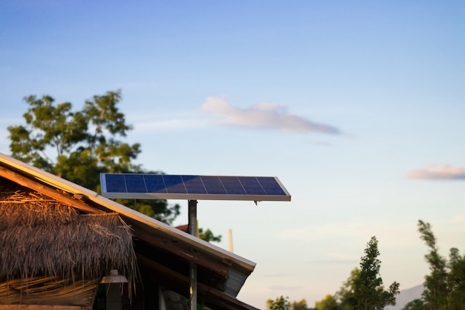
Maximizing Solar Efficiency
To maximize electricity generation,
the solar panel should face
the sun all time.
In this project, we will build
an Automatic Sun Tracking System
for the solar panel to track
the position of the sun.

Slide 8
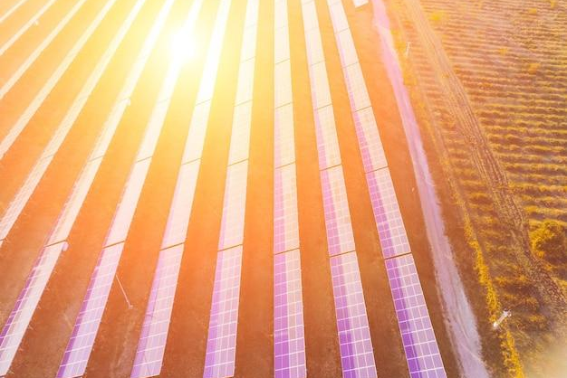
Tracking the Sun
Tracking the Sun is the process of following the sun's movement i.e. determining it’s position from a reference point.
Using LDRs, we can create a system that
tracks the sun's position. This info can be used to adjust the orientation of solar panel.
As we are implementing this project in a lab, we will use mobile torch as the light
source to replicate the sun.

Slide 9
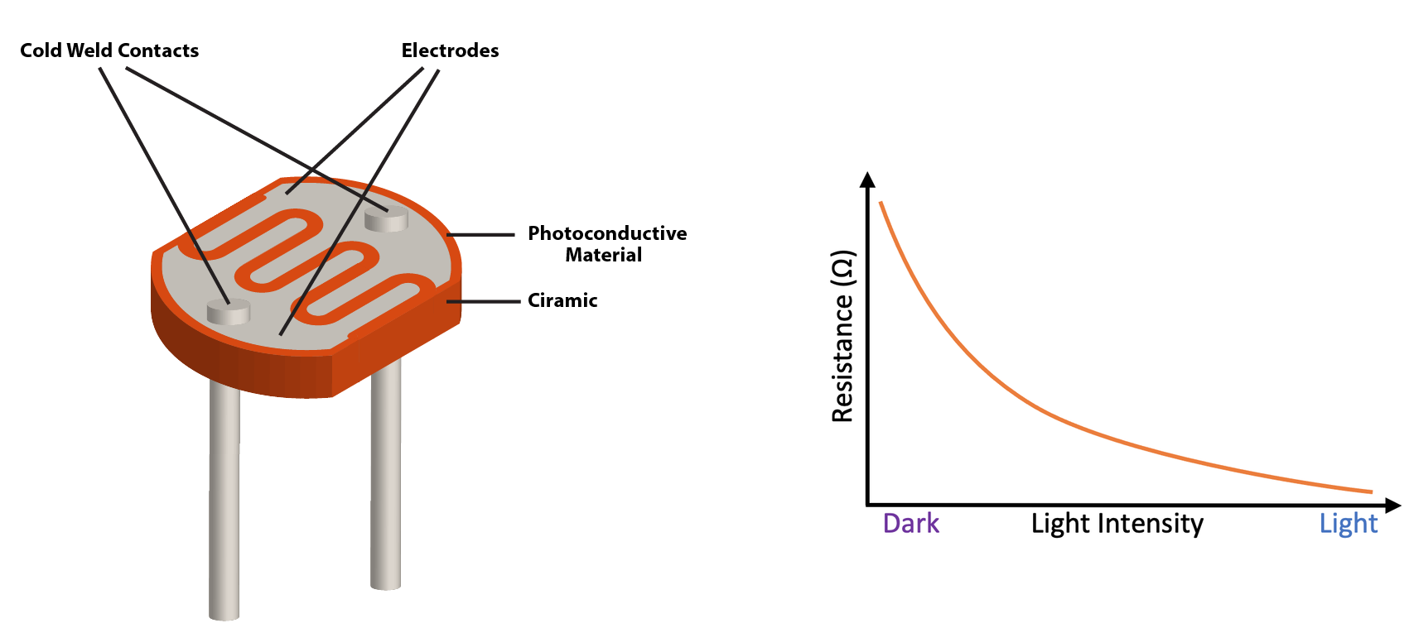
Intro to LDR (Light Dependent Resistor)
LDRs are resistors that change their resistance based on the intensity
of the light they receive.
Construction and
materials determine their sensitivity to light.

Slide 10
Intro to LDR (Light Dependent Resistor)
Conductivity of LDR increases with light. When light hits an LDR, it excites electrons, which reduces the resistance of the material.
This resistance can be used
to control the voltage of a specific node of a circuit which can be used to control other circuit components.

Slide 11
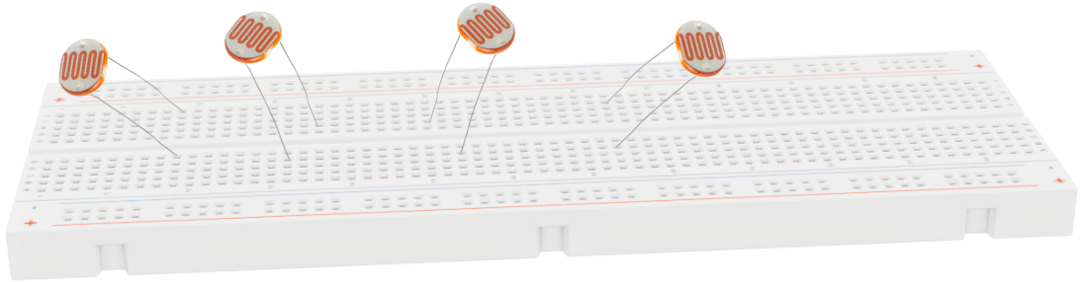
LDR Setup
Multiple LDRs are required to determine the position of the Light source. Also, they should be placed in the breadboard in different angles each corresponding to different angular position of the light source.

Slide 12
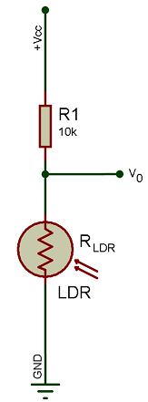
LDR Setup
Each LDR is connected to a circuit like the figure in the left. The output voltage, V_{O} can be calculated using the following equation,
V_{O} = V_{CC} * R_{LDR}/(R₁+R_{LDR})
R_{LDR} varies according to the intensity of the incident light and V_{O} changes accordingly. This voltage can be used to determine the position of the light source.

Slide 13
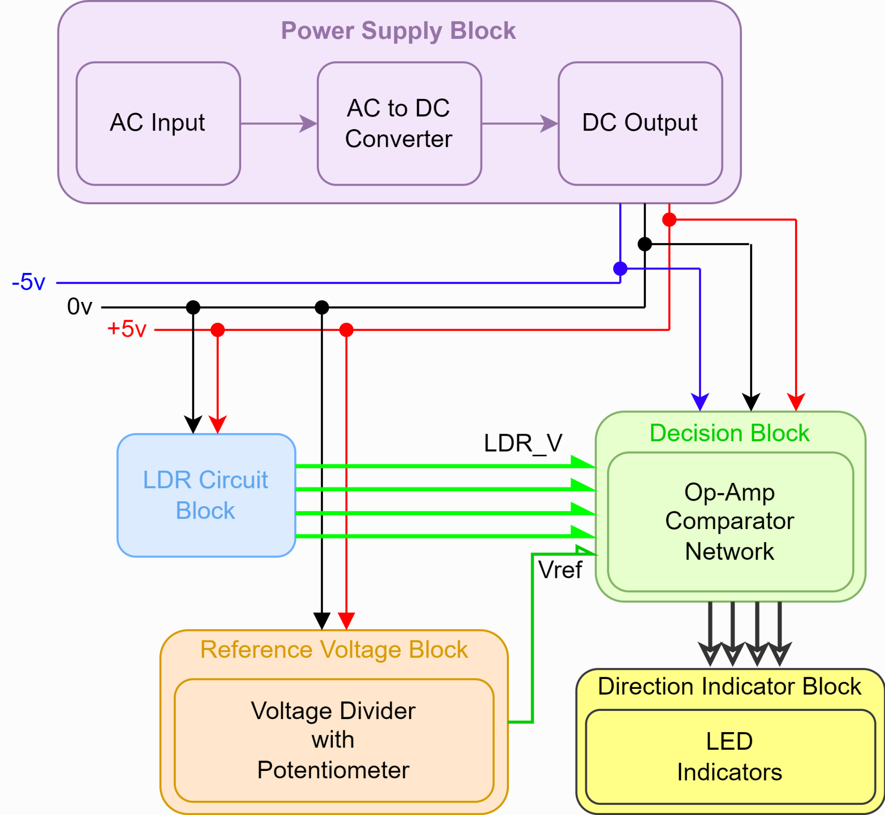
Building Blocks
Breaking down the project problem into smaller, more manageable components can make it easier to understand and build.
By breaking a complex project into smaller blocks, it becomes possible to focus on specific aspects of the project and develop solutions for that block.

Slide 14
Building Blocks
This can also help to identify any dependencies or interactions between different blocks, which can be important for understanding the overall project.
Additionally, breaking down a project can make it easier to test and debug the project.

Slide 15
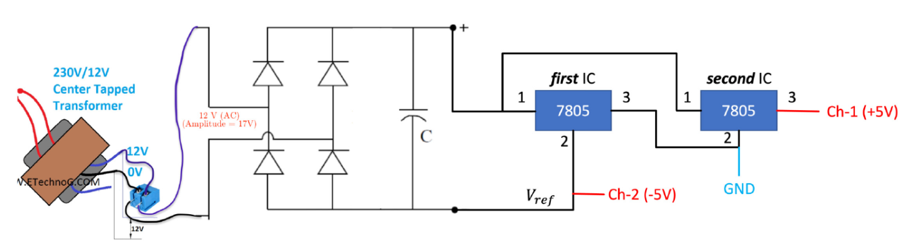
Power Supply Block
Most electronic components and devices, are designed to operate on DC power. To use power from the electrical grid, which is in the form of AC power, it needs to be converted from AC to DC to operate electronic components. This power supply block serves as a bridge between the AC power source and the DC-powered electronic components, allowing them to function properly.

Slide 16
Power Supply Block
The block has –
Step-down Transformer: for high voltage AC to low voltage AC conversion
Full-wave Rectifier: for AC to DC conversion
Voltage Regulator(7805 IC): for stable DC output

Slide 17
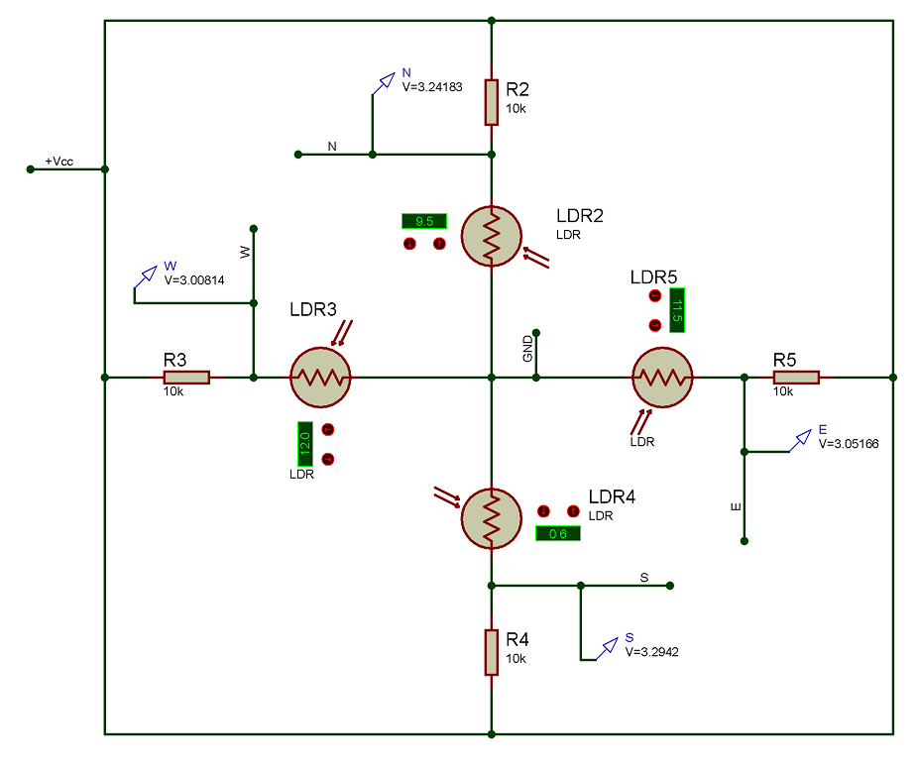
LDR Circuit Block
This block will generate voltages according to the intensity of the incident light on the LDRs.
These voltages will be used in the Decision block to indicate the direction of the light source

Slide 18
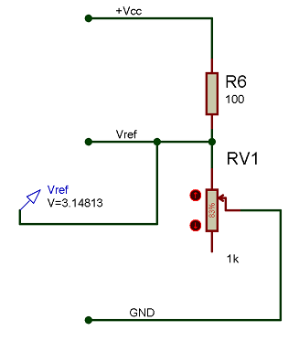
Reference Voltage Block
This block will generate the reference voltage, V_{ref} which will be used
in the Decision block to indicate
the direction of the light source.
V_{ref} can be tuned using a Potentiometer.

Slide 19
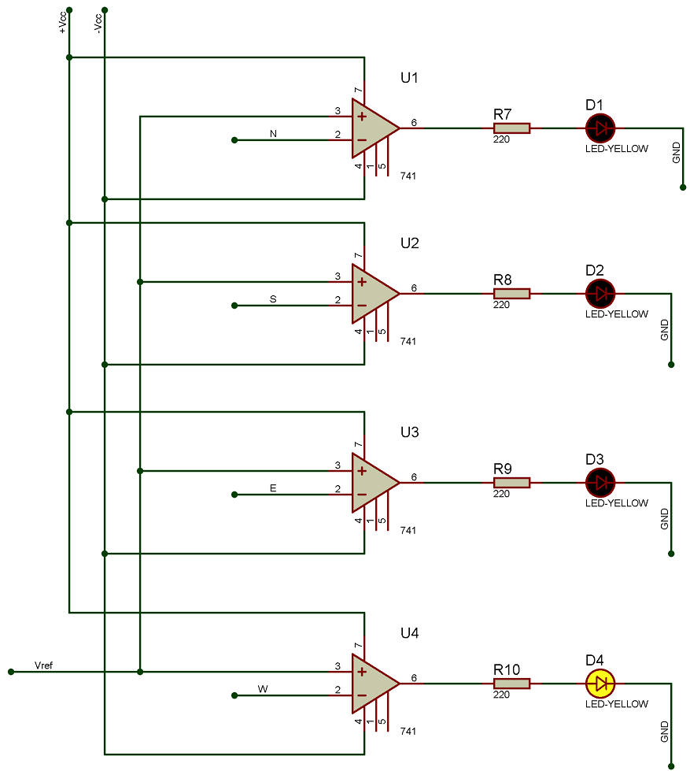
Decision Block & Direction Indicator Block
The decision block contains 4 comparators. They compare the output voltages of the LDR block and V_{ref} in order to determine which comparator should give a high voltage at the output. The comparators are connected to LEDs which are part of the indicator block.
The circuit will be tuned in such a way that, if light source is present only one LED will be ON which will indicate the position of the light source.

Slide 20
Thank You!
Any Question?

